Slide 1
Phishing Attacks and awareness

Slide 2
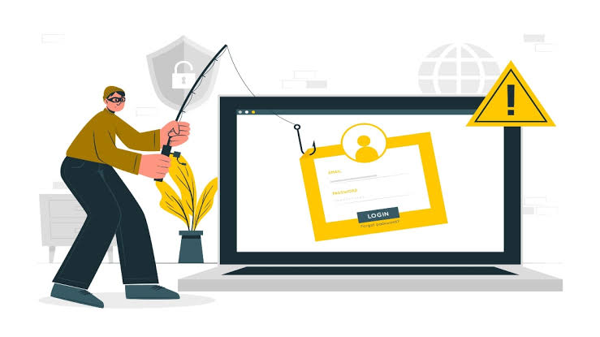
What is phishing?
Phishing is a type of cyber attack where attackers try to trick individuals into revealing sensitive information, such as passwords or financial information.

Slide 3

Phishing is a type of social engineering attack that uses fake emails, messages, or websites to trick individuals into revealing sensitive information.

Slide 4
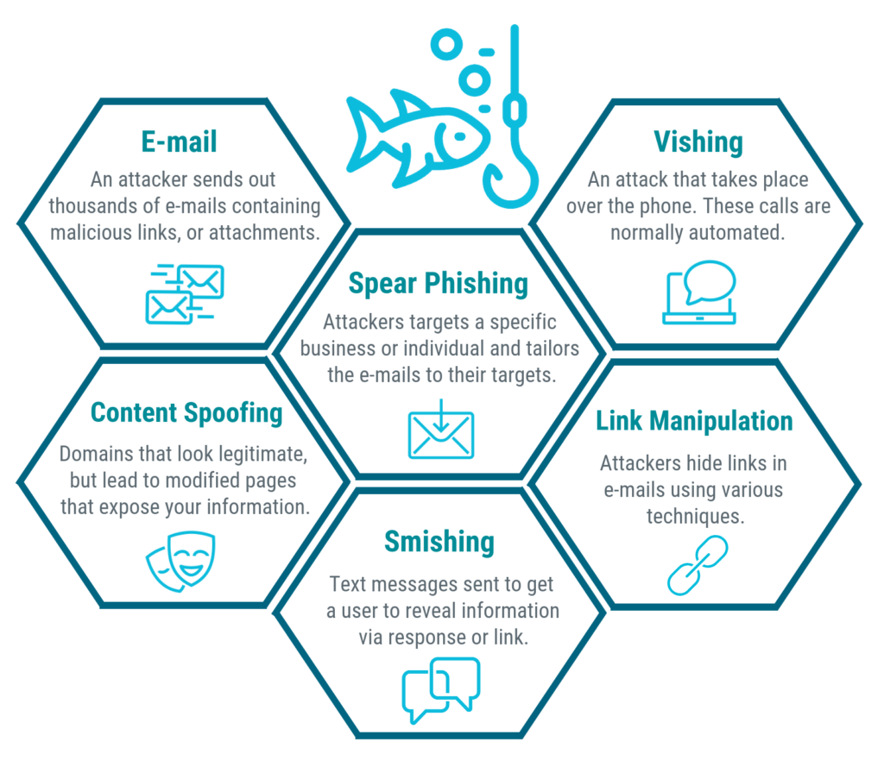
Types of Phishing Attacks
- Email phishing
- Spear phishing
- Whaling
- Smishing
- Vishing

Slide 5
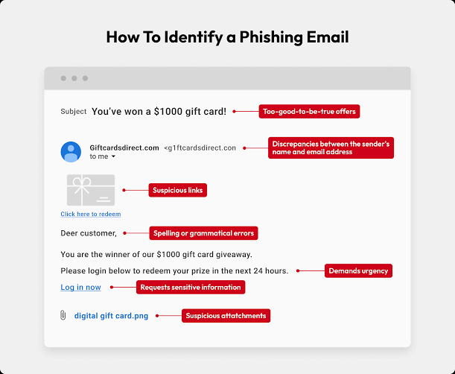
Email Phishing
Email phishing is a type of phishing attack where attackers send fake emails that appear to be from a legitimate source, such as a bank or online retailer

Slide 6
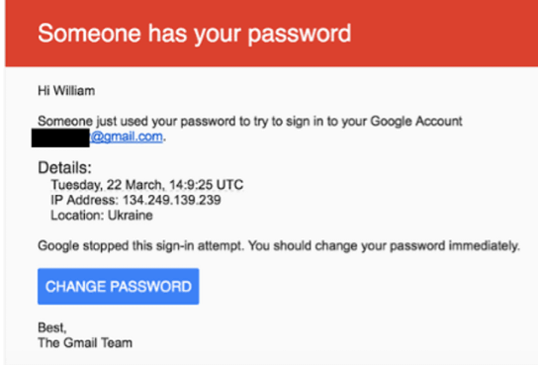
Spear phishing
Spear phishing is a type of phishing attack where the attackers target specific individuals or groups, often using personalized information to make the email appear more legitimate

Slide 7
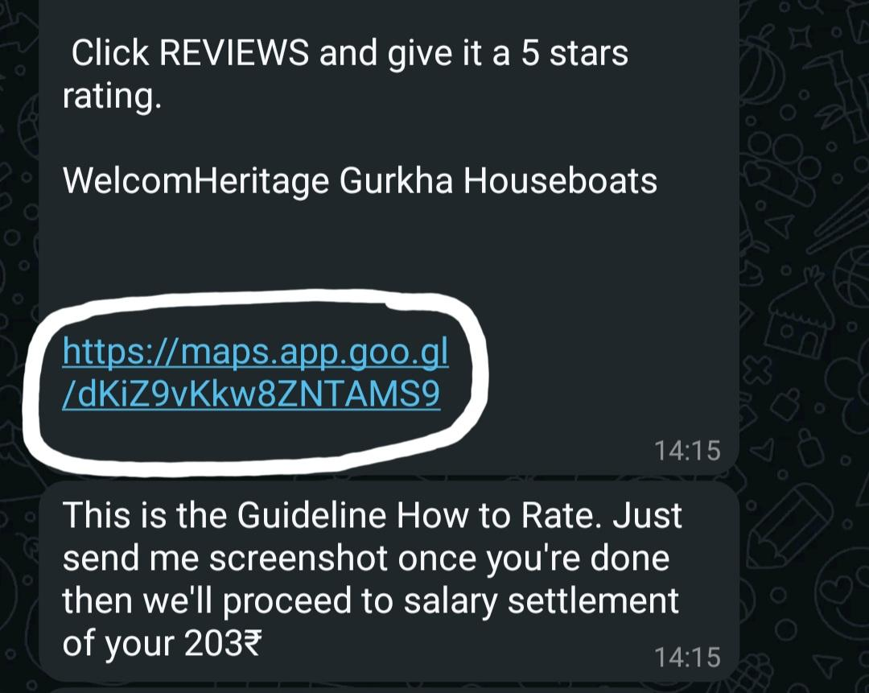
How to find phishing attack
Suspicious sender email addresses
Generic greetings
Spelling and grammar mistakes
Urgent or threatening tone
Suspicious links or attachments

Slide 8

Protect yourself
Verify sender information
Be cautious with links and attachments
Use strong passwords
Enable two-factor authentication
Keep software up-to-date

Slide 9

Best practices for phishing awareness
- Use antivirus software
- Use a firewall
- Back up data regularly
- Educate others about phishing attacks

Slide 10
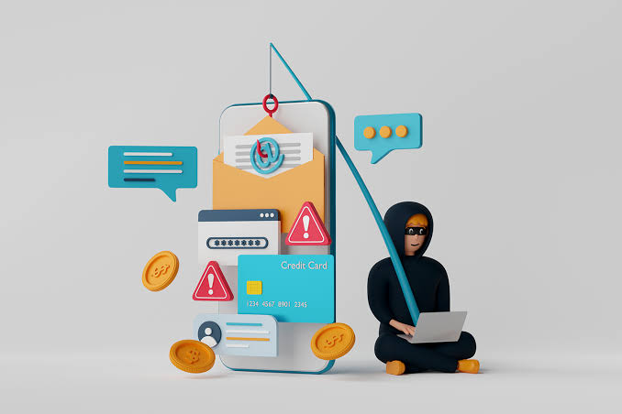
Conclusion
Phishing attacks are a serious threat, but by being aware of the risks and taking steps to protect yourself, you can reduce the likelihood of falling victim to a phishing attack.
Call to action: "Stay safe online!"

